Slide 1

Mobileye Project
Traffic Lights Detection
Naor Br Kochva - Yaakov Brin - Michael Bergshtein

Slide 2
Mobileye Project
Traffic Lights Detection
Part 1
detect candidates
Part 2
decide which are TFLs
Part 3
estimate distances

Slide 3

Part 1
detect candidates
creating the kernel
optimize detection of traffic lights

Slide 4


Part 1
Creating the Kernel
make kernel with image
Make the kernel sum of values in pixels to 0
(like in high pass)
convolve the gray image with the kernel
detect most of traffic lights using NMS

Slide 5
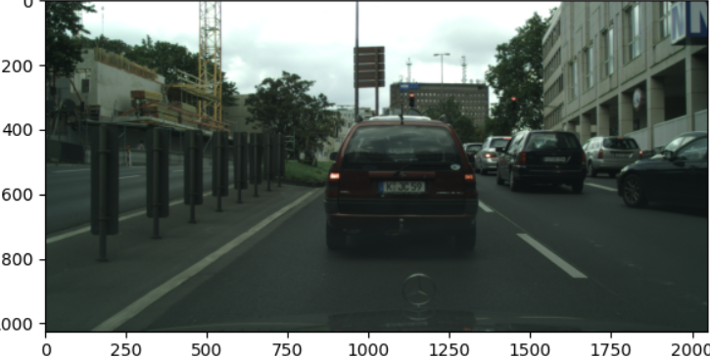
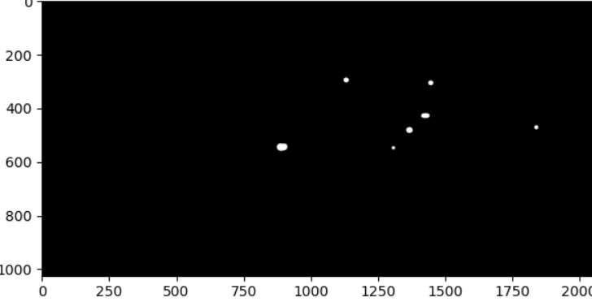
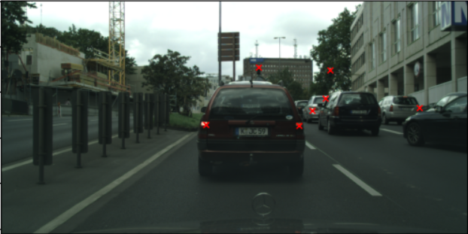
Part 1
Improving the TFL detection
build a mask which filters colors of TFL
using blurring and threshold
from there continue the process

Slide 6
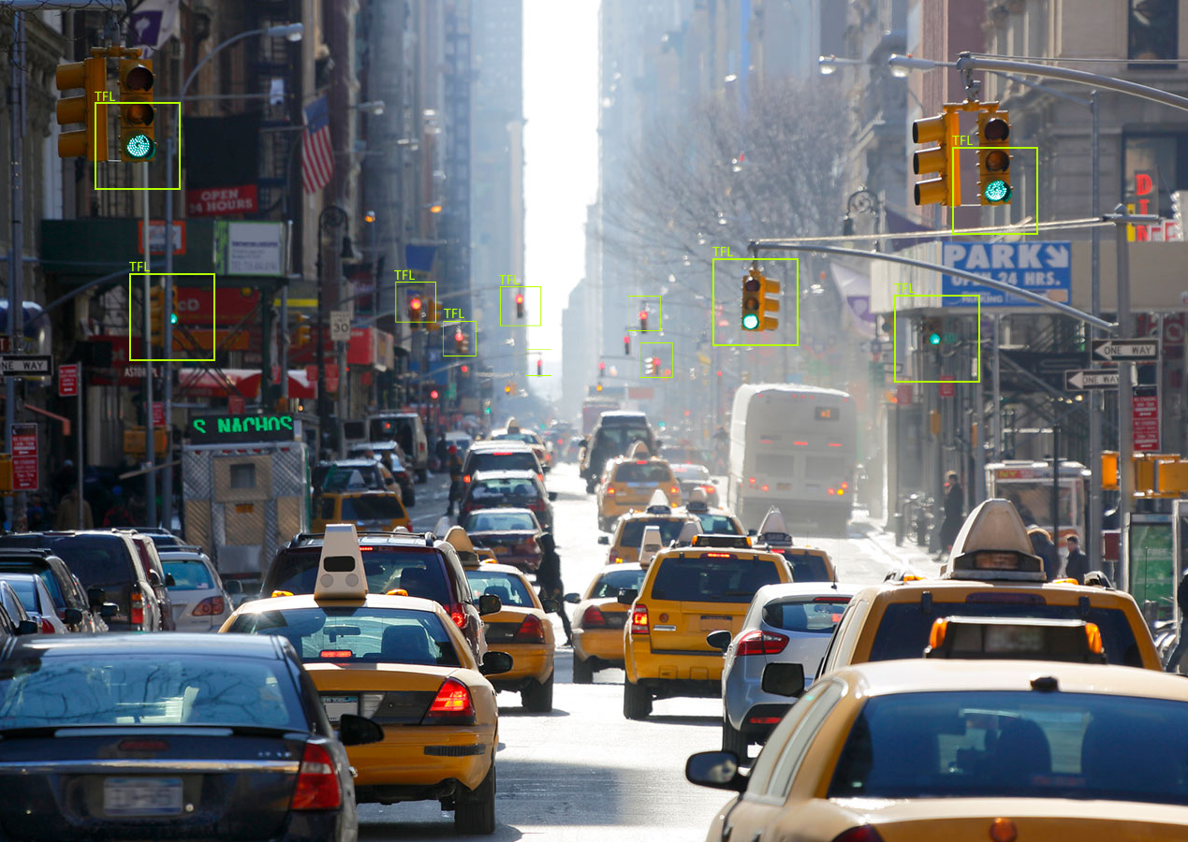
Part 2
decide which are TFLs
creating the dataset (using augmentation)
creating the neural network model
facing difficulties

Slide 7
Part 2
Creating the dataset
make 2 lists of images: tfl_list, no_tfl_list
each point converted to 81x81x3 image
for each point – if id=19: then add to tfl_list
else: add to no_tfl_list
balance the number of images in the 2 lists
using augmentation (mirror the images)
if that’s not enough: remove surplus images

Slide 8
Part 2
Creating the neural network model
adding layers
bigger kernels (5x5)
Dropout and MaxPooling2D
accuracy of model on the valuation images is 0.938
(without using a trained network)

Slide 9
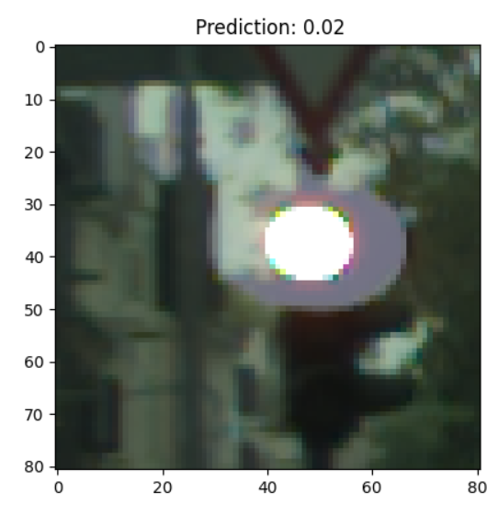
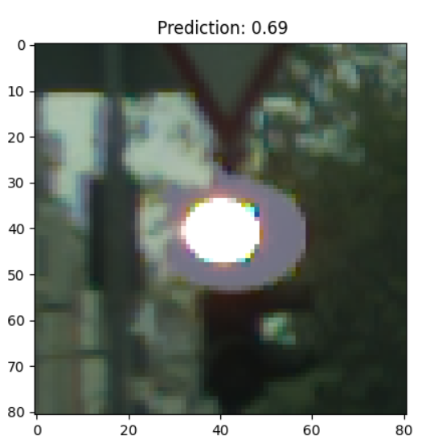
Part 2
Before
Facing difficulties
The model didn’t recognize some clear traffic lights
we found out that in most of those images the TFLs light doesn't appear in center
we made a better mask from part 1 so we get images which their TFL light located at central
After

Slide 10

Part 3
estimate distances
using SFM
facing difficulties

Slide 11
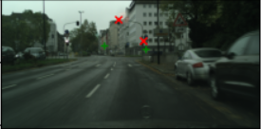
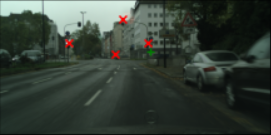
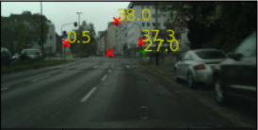
Frame 26
Part 3
Facing bugs at integration
The locations of the TFLs are inconsistent:
in some cases, some TFLs in one frame detected by the neural network and not
in the next one (the same in opposite)
Frame 27
Frames 26-27

Slide 12
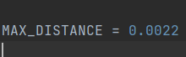
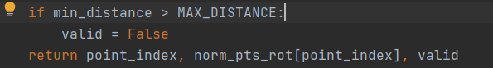
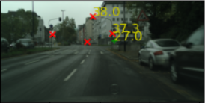
Frame 26
Part 3
Facing bugs at integration
We defined a threshold of maximum distance
from the epipolar line to the closest rotated point
by that it updates the valid list
Frame 27
Frames 26-27

